Slide 1
Command Injection
By –Prakash Khasor, Assistant Professor(Cyber Security), National Forensic Sciences University

Slide 2
Introduction
What is command injection?
Methodology for Penetration Testing
Prevention or Solution

Slide 3
Command injection?
Command injection is an attack in which the goal is execution of arbitrary commands on the host operating system via a vulnerable application. Command injection attacks are possible when an application passes unsafe user supplied data (forms, cookies, HTTP headers etc.) to a system shell(OWASP).
Operating system command injection vulnerabilities arise when an application incorporates user-controllable data into a command that is processed by a shell command interpreter.

Slide 4
Continue….
If the user data is not strictly validated, an attacker can use shell meta-characters to modify the command that is executed, and inject arbitrary further commands that will be executed by the server.
OS command injection vulnerabilities are usually very serious and may lead to compromise of the server hosting the application, or of the application's own data and functionality. It may also be possible to use the server as a platform for attacks against other systems. The exact potential for exploitation depends upon the security context in which the command is executed, and the privileges that this context has regarding sensitive resources on the server.

Slide 5
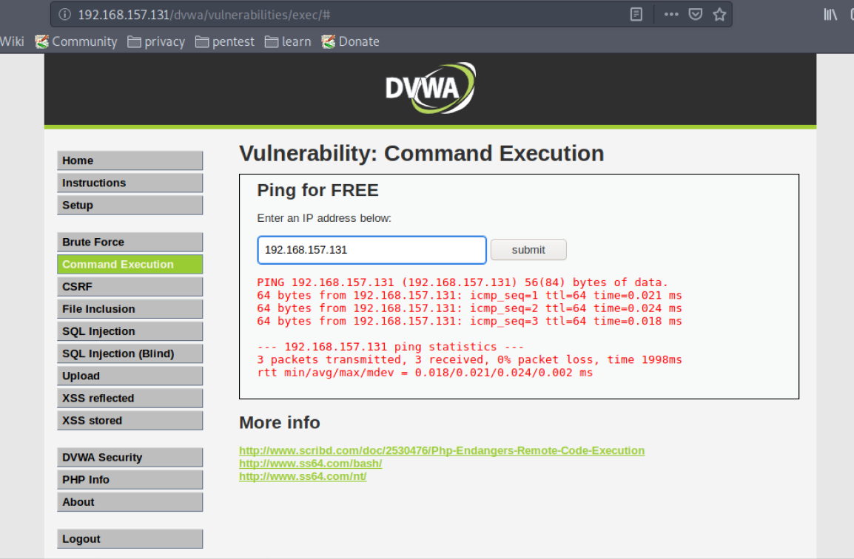
Practical
Purpose of command | Linux | Windows
Name of current user | whoami | whoami
Operating system | uname -a | ver
Network configuration | ifconfig | ipconfig /all
Network connections | netstat -an | netstat -an
Running processes | ps -ef | tasklist
We will use DVWA for Practicals
Security:-Low

Slide 6
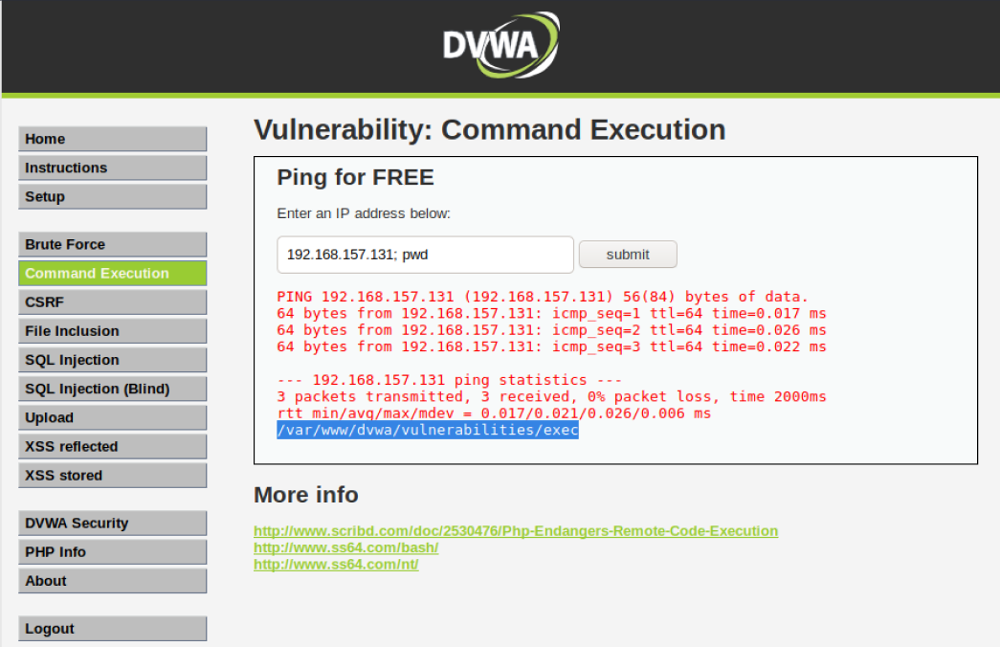
Continue….
Underlying code does not check if $target matches an IP Address. No filtering on special characters.
Other special characters we can use:-
&& - AND Operator
| - PIPE Operator - Completely removes IP address from output.

Slide 7
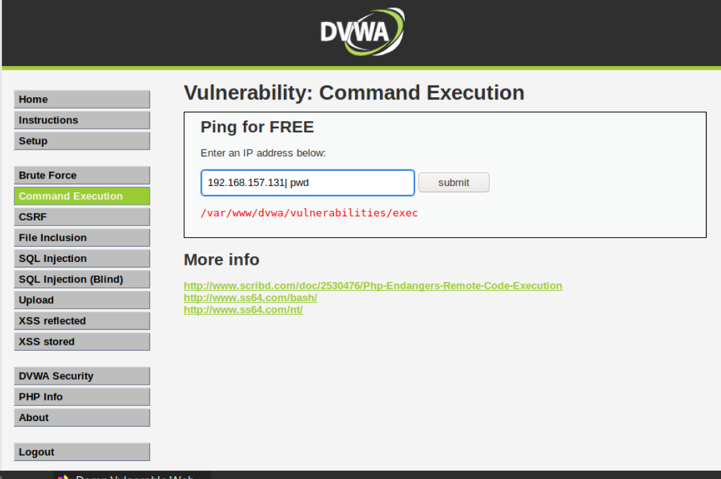
Continue….
Security:-Medium
After Viewing source code, we see that a blacklist has been set to exclude && and ;. As noted above, we used | as a replacement.

Slide 8
Prevention:-
Validating against a whitelist of permitted values.
Validating that the input is a number.
Validating that the input contains only alphanumeric characters, no other syntax or whitespace.
For more Information:- ‘‘https://owasp.org/www-community/attacks/Command_Injection#:~:text=Description,.)%20to%20a%20system%20shell.’’
https://owasp.org/www-project-web-security-testing-guide/latest/4-Web_Application_Security_Testing/07-Input_Validation_Testing/12-Testing_for_Command_Injection

Slide 9
